Slide 1
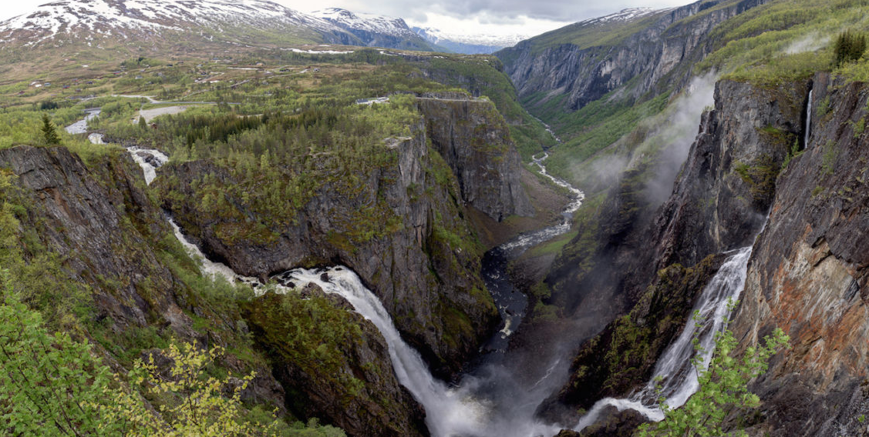
Outland Adventures
By Rusty Degarmo, Mitchell Kwon, Aurora Lopez,
Lucas Ramsey and Parrish Ward
Notes:
Introduction of Team Alpha

Slide 2
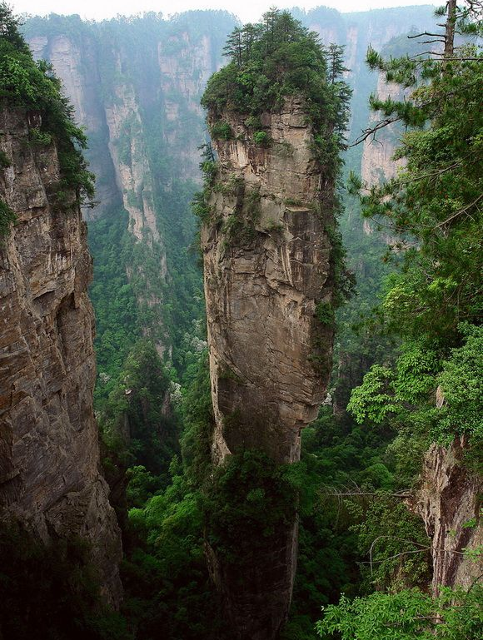
Case Study-Overview
Blythe Timmerson and Jim Ford, both outdoor enthusiasts, opened Outland Adventures.
They hired two guides; John ‘Mac’ MacNell, and D.B. ‘Duke’ Marland.
So far, they have conducted treks in Africa, Asia, and Southern Europe.
Customers may either rent or buy their equipment outright.
TZhangjiajie National Forest Park in China, 2019
Notes:
Can discuss about needed supplies and guides’ general duties including in charge of organizing and planning the trips, including investigating airfares, visa requirements, and inoculations

Slide 3
Three
Do enough customers buy equipment to keep equipment sales?
Is there a downward trend in bookings?
Are there inventory items that are over five years old?
Questions?

Slide 4
GUIDE
guide_id= 1 first_name=”John” last_name= “MacNell”
1.1
has
1.1
TRIP
trip_id= “A001” destination_name=”Southern Europe arrival_date= “01/01/2021” departure_date= “01/14/2021” guide_id= “1”
O
R
D
1.1
has
1*
1.1
has
1*
1.1
has
1*
CUSTOMER
customer_id= “001” first_name= “Luis” last_name= “Santos” trip_id= “A001” supplies= “rented or bought”
SUPPLIES
trip_id=”A001” equipment_name=”E-12-N quantity_needed=2 equipment_cost= 31.50 inventory_in_stock= 31 date_added= “01/01/2021”
1.1
has
1*
Business Rules:
•One guide has many customers. •One customer has many supplies. •One trip has many supplies.
•One guide has one trip. •Many customers have one trip.

Slide 5
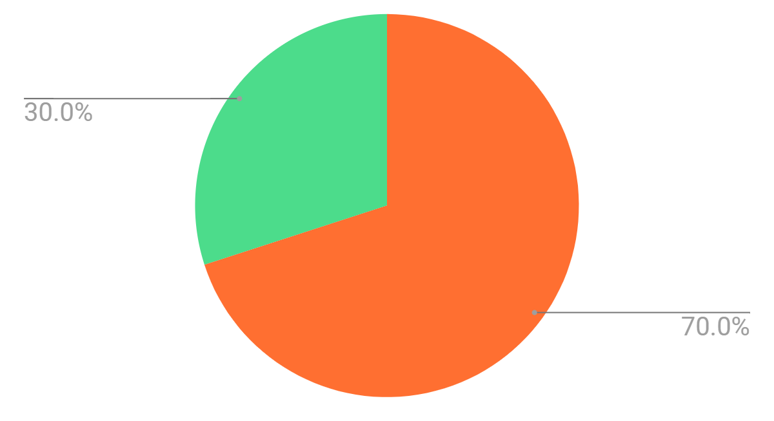
Do enough customers buy equipment to keep equipment sales?
70% of customers rent the equipment
30% of customers bought the equipment
Notes:
We created a query on the Customer table to count how many customers buy and how many rent their equipment.
Due to our anonymous data collection policy, we collected numbers and not names. We make personas to represent these
New database results=30%. Still worth it.

Slide 6
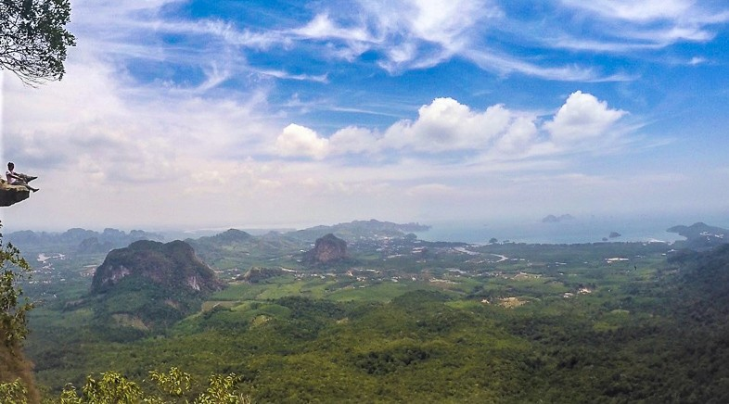
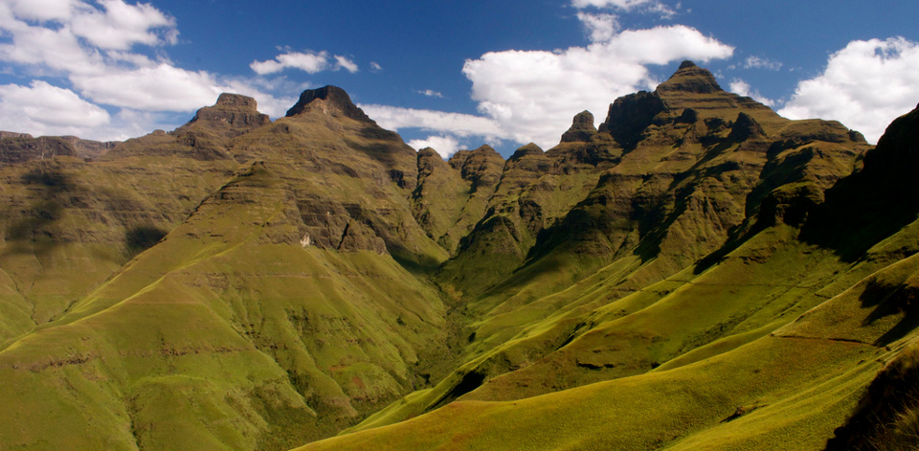
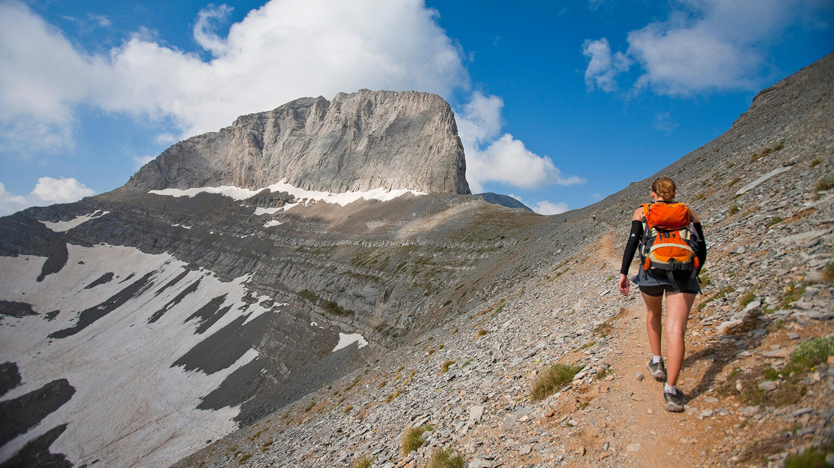
Is there a downward trend in bookings?
Thailand
2019
South Africa
2018
3 treks to Africa
4 treks to Southern Europe
4 treks to Asia
Greece
2017
Notes:
We created a query on the Trip table to count how many treks there have been to each location. As you can see, based off of this months pull of the new database we have more business. However Africa’s result is misleading due to Mrs. Culligans family extending their trip.(because we have 1 more trip than listed customers)

Slide 7
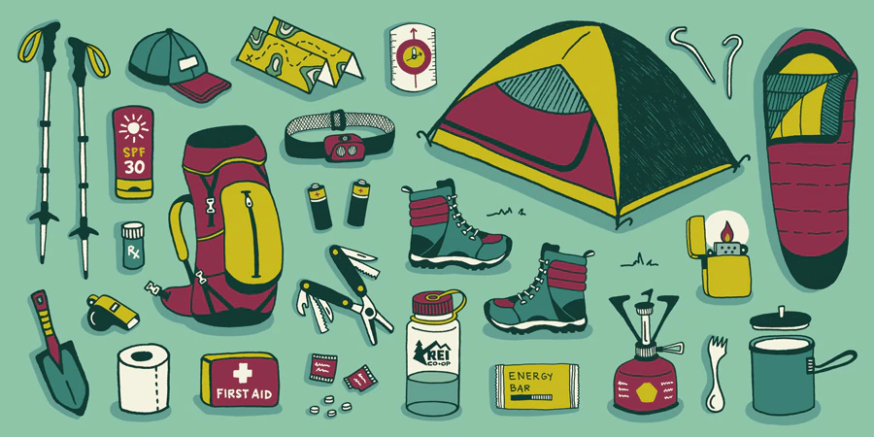
Are there inventory items that are over five years old?
No supplies are older than 5 years old
Notes:
We created a query for the Supply table to count how much of the inventory is more than five (5) years old.We currently have no supplies over 5 years old. We just donated the oldest supplies to the instructor course on main.

Slide 8
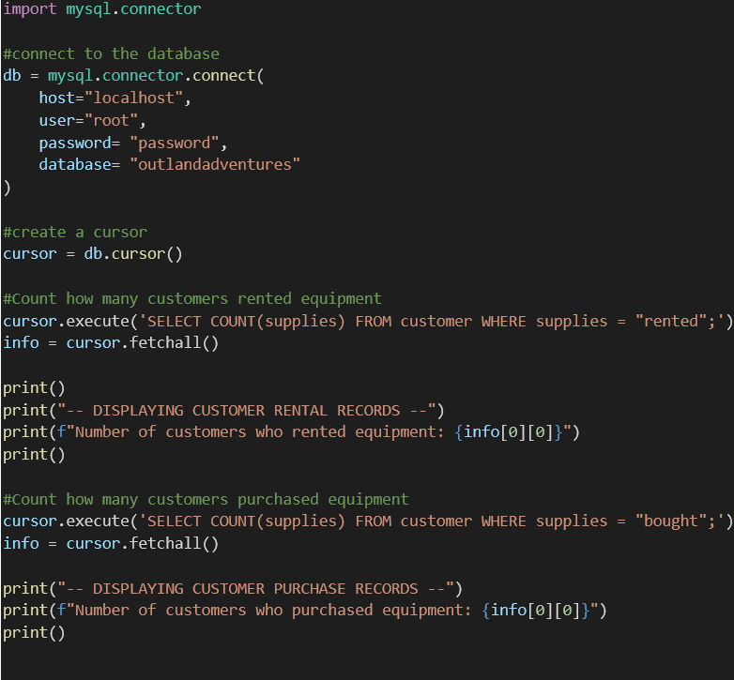
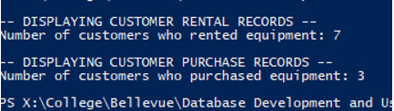
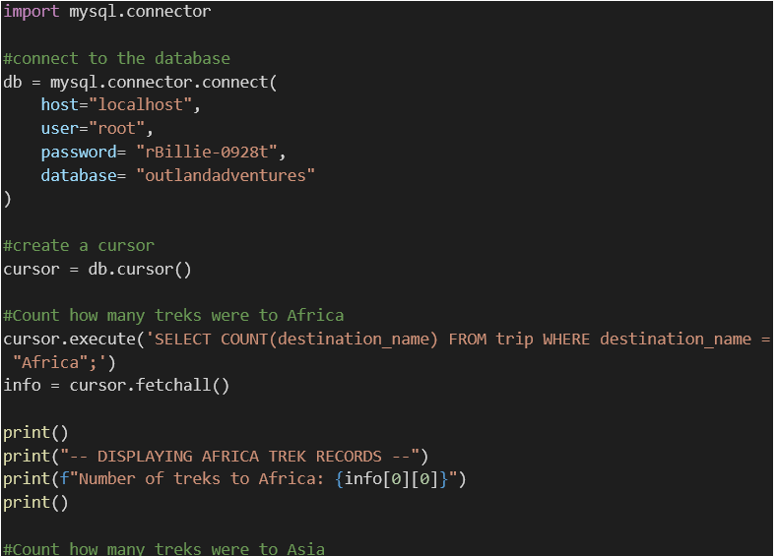
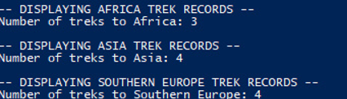
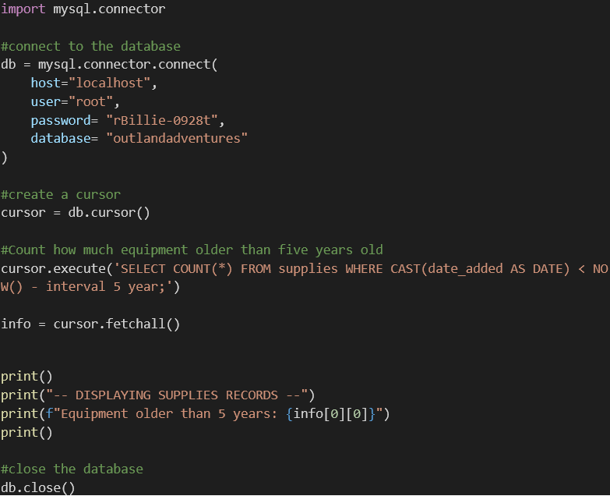
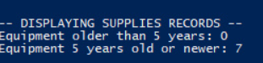
Reports
#1
Bought vs Rented
#2
Number of treks
#3
Supplies older than 5 years

Slide 9
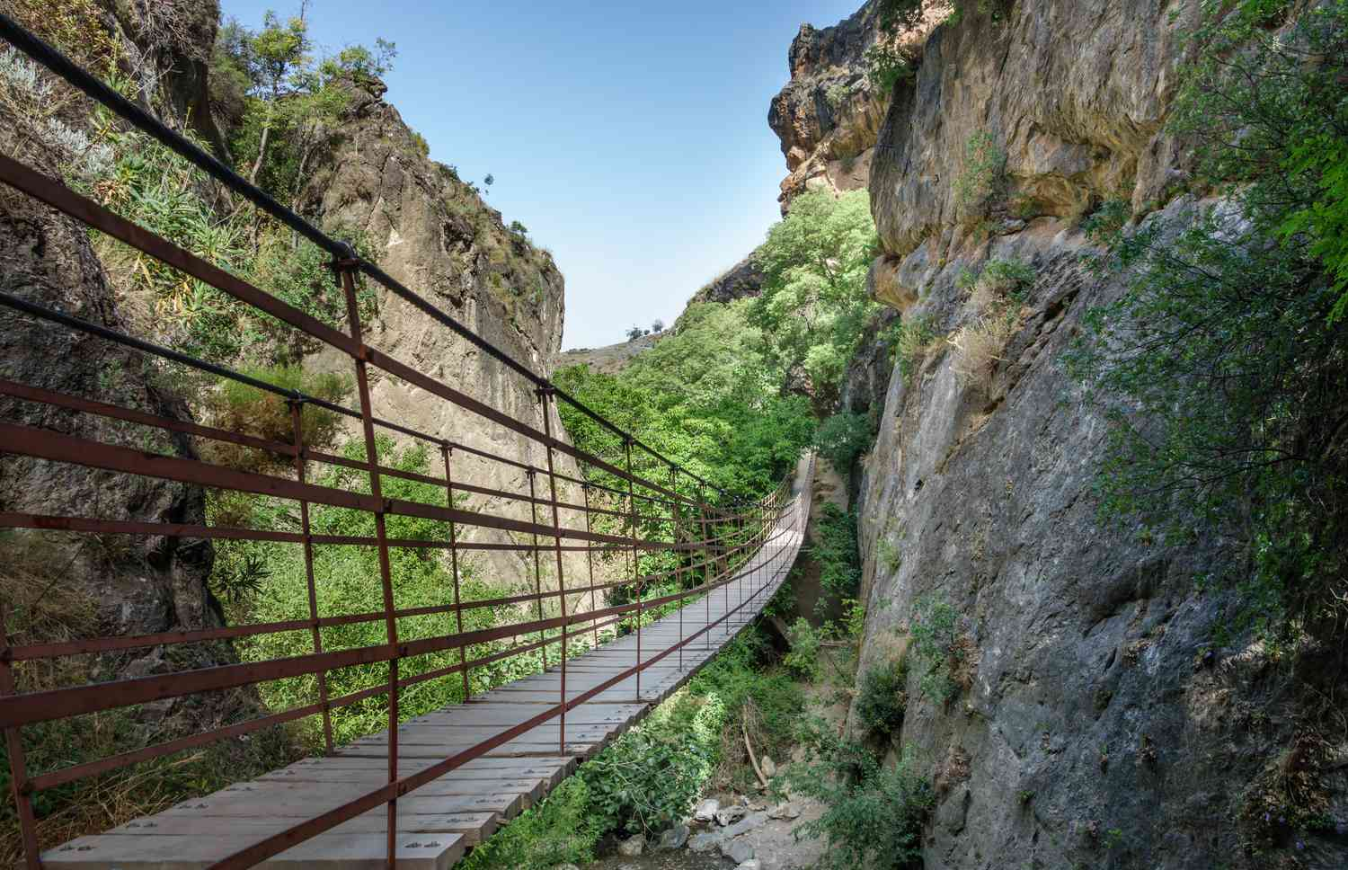
Assumptions made
That the guides go on the trips as well.
The guides are both experts at all three trek locations
The business has brick and mortar locations with warehouses for supplies storage in each location
Guides already have their supplies needed for each location and will not need log their supplies in the database
The customers will not bring their own supplies to the trips they will either buy or rent
They have enough data from each location and bookings to observe trends within the data in order to make assessments
The equipment will be sold and rented as a set
Notes:
Read the assumptions and further elaborate if needed.

